Slide 1
WHY DATA?
(Clearing the conundrum around data and stepping into the big data era)
AVIRUP CHATTARAJ

Slide 2
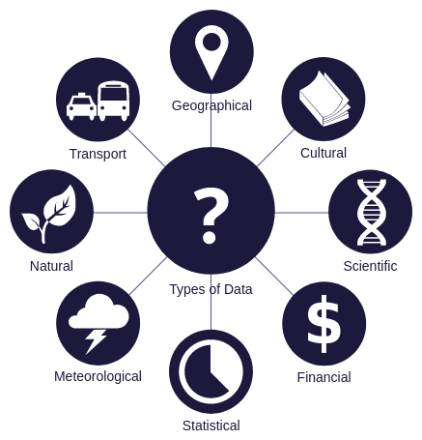
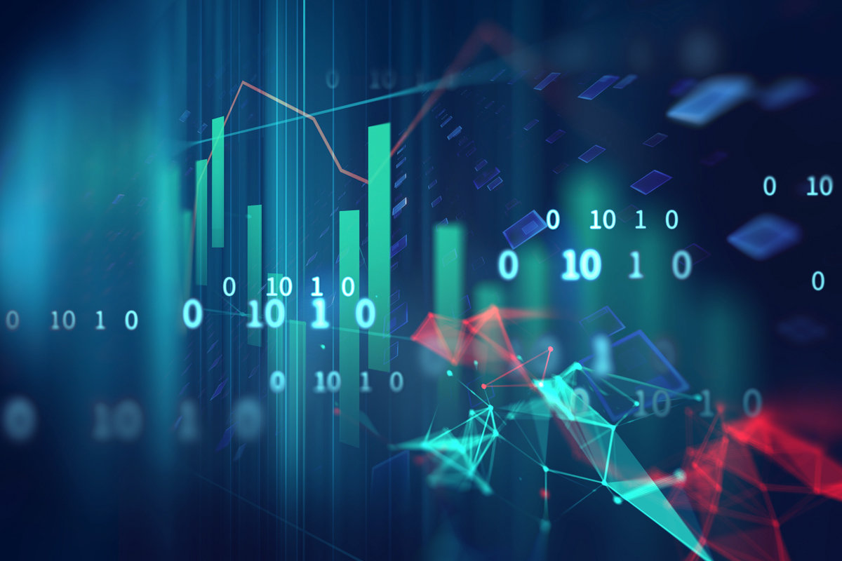
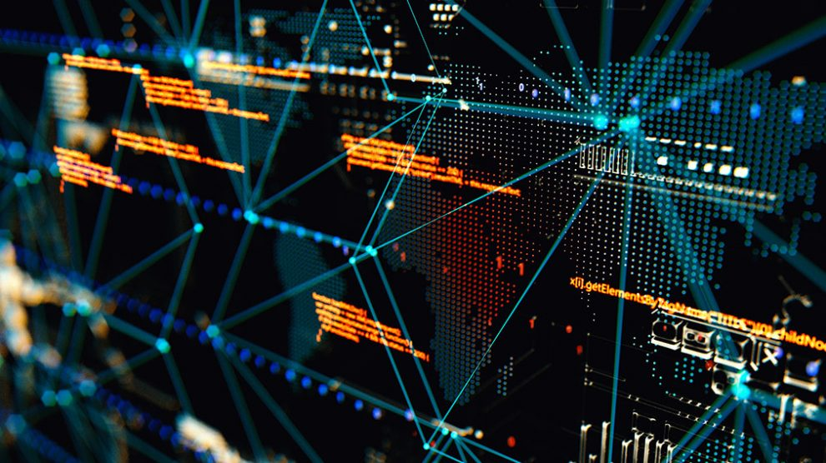
WHAT IS DATA?
Data has been touted as the new oil. It's valuable but if unrefined cannot be really used.
Data Science,Business Intelligence, Machine Learning,Big data everything relies on data so let's understand it deeply.

Slide 3
DEFINITIONS ABOUT DATA
DATA can be simply defined as a raw fact which when processed leads to actionable insight.
Data can also be defined as a set of values of qualitative or quantitative variables.
It's on this data that Data Science,Business Intelligence, Machine Learning, Big Data based on........

Slide 4
DISSECTING MEANING OF DATA
A set of values- Here a set of values refers to the population against which insights are made
Qualitative- Measurement or information about qualities
Quantities-Measurement or information about quantities
Variables-Measurement or characteristics about items.

Slide 5
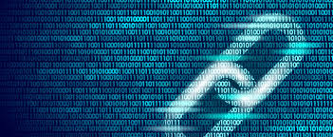
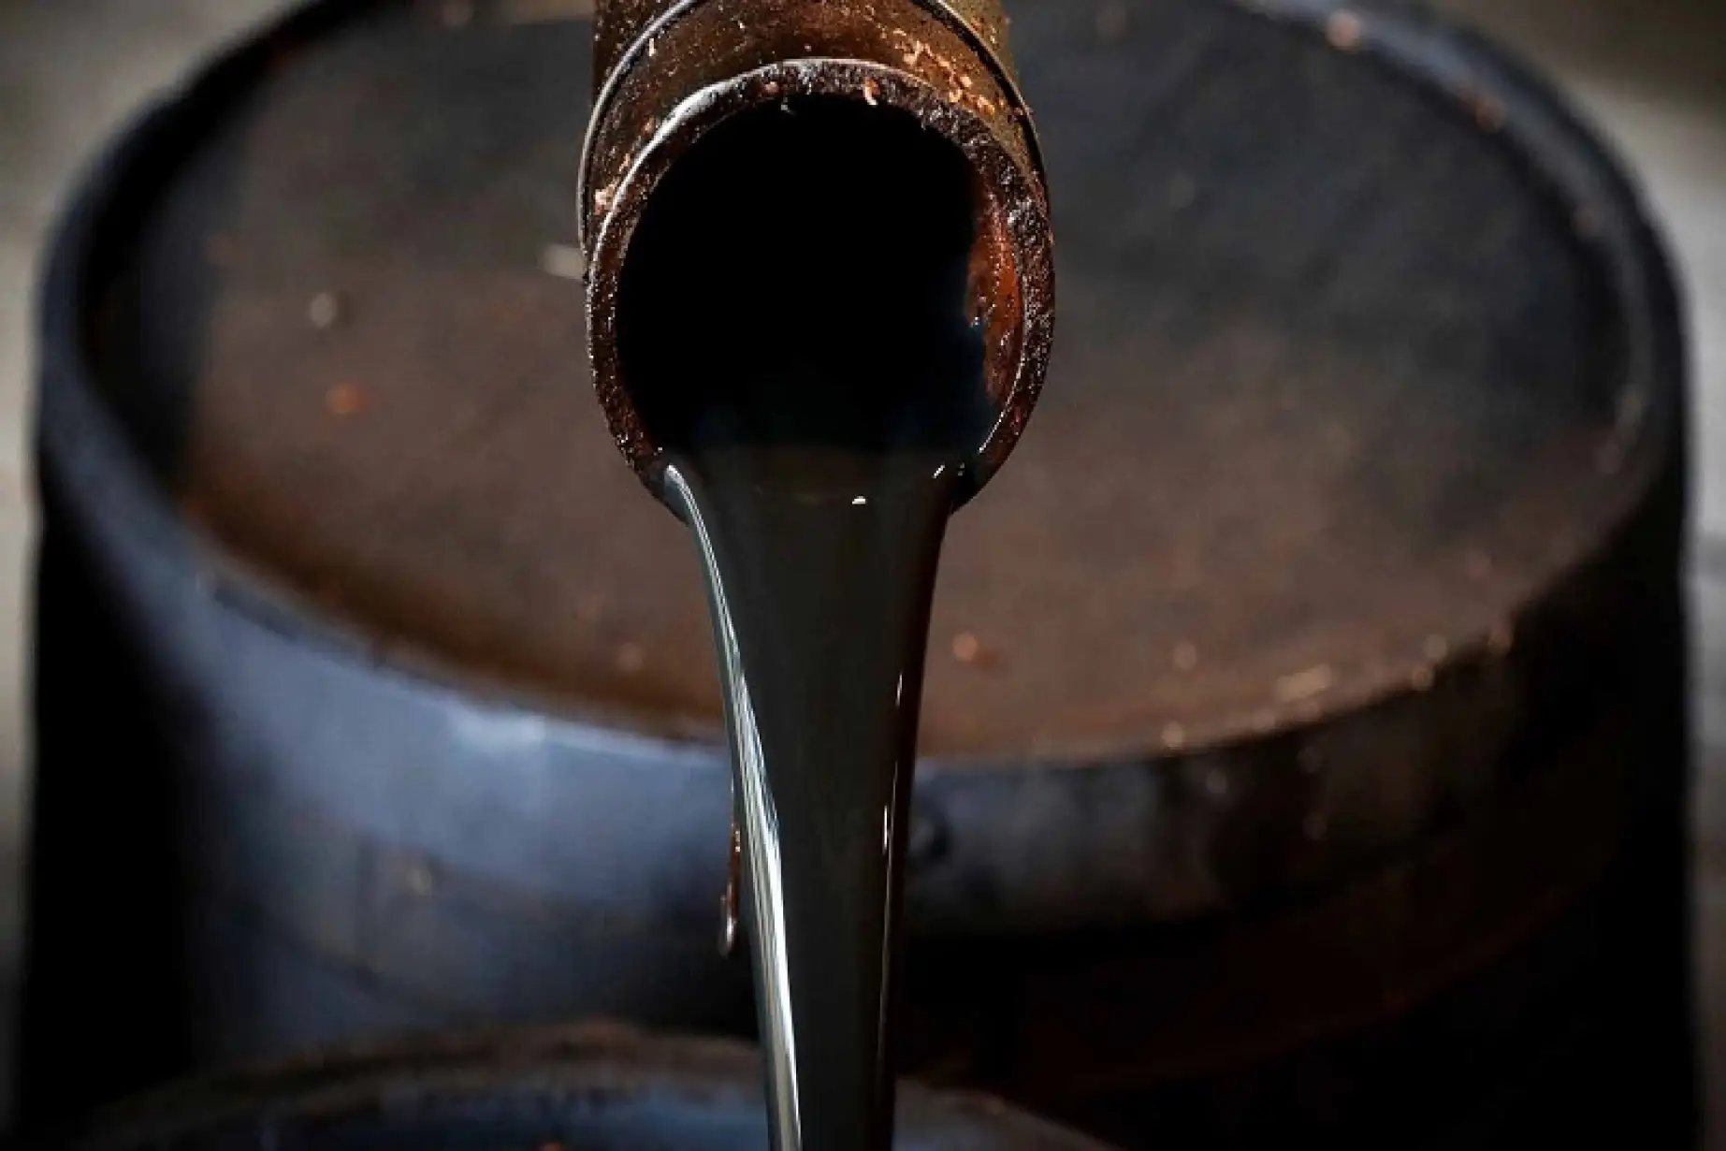
WHY IS DATA AND OIL SO SIMILAR???
Data can only be used if its properly refined.
When data is properly refined it leads to insights.
Oil typically referring here to crude oil can only be used if its properly refined.
When crude oil is refined it typically leads to many essential products such as petrol,diesel etc.

Slide 6
HOW IS DATA USED IN A COMPANY??
Data Team and the Big Data Team-Mainly works with the preexisting data
Business Intelligence Team-Mainly creates dashboards for the company
Data Science Team-Use business analytics and data analytics to build models

Slide 7
Constant Evolution of the Data Science Industry
Statistician-Role of gathering and cleaning data
-Applying statistical methods
Data Mining-Extract patterns of the data
Predictive Analytics-Using new statistical models make more accurate forecasts
Data Scientist-what we have in the 21st century
Statistician Data Mining Predictive Analytics Data Scientist

Slide 8
A BIG QUESTION NOW
IS ANALYTICS AND ANALYSIS SAME??

Slide 9

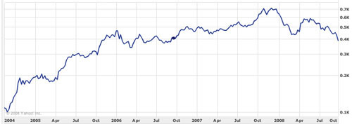
ANALYSIS
Analysis is mostly done to explain the past events.
Qualitative Analysis-Basically explain how and why regarding an event
Quantitative Analysis-Using data to explain why and how

Slide 10
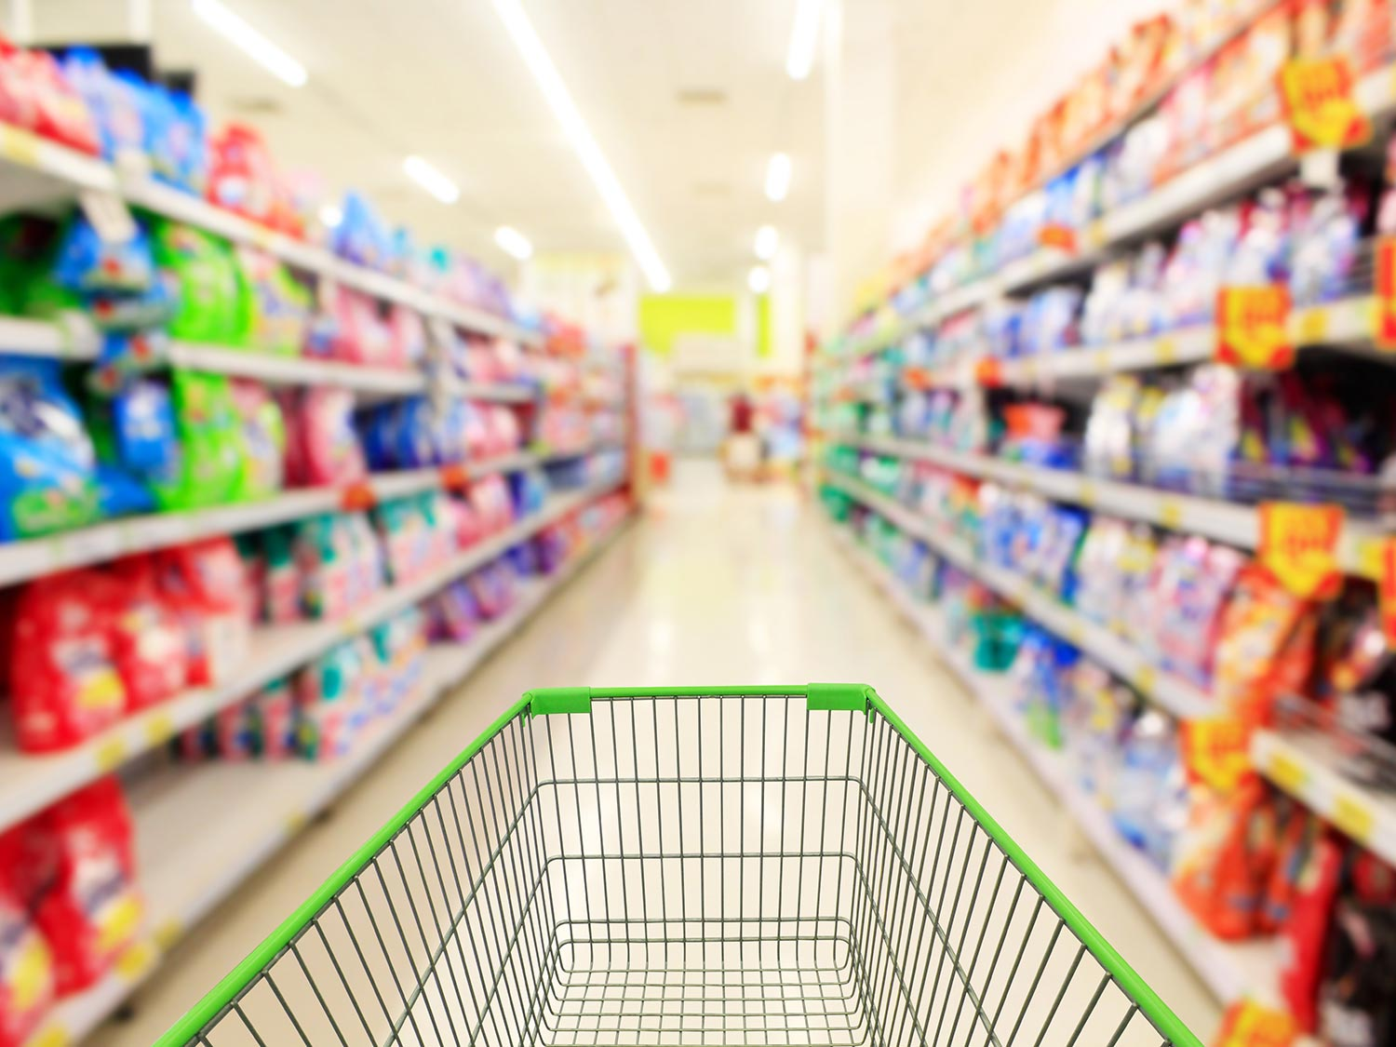
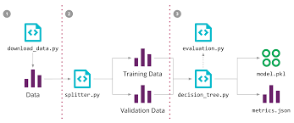
ANALYTICS
Analytics is mostly used for predicting future outcomes
Qualitative Analytics-Using our intuition coupled with past data
Quantitative Analytics-Using formulas and algorithms to predict future outcomes.

Slide 11
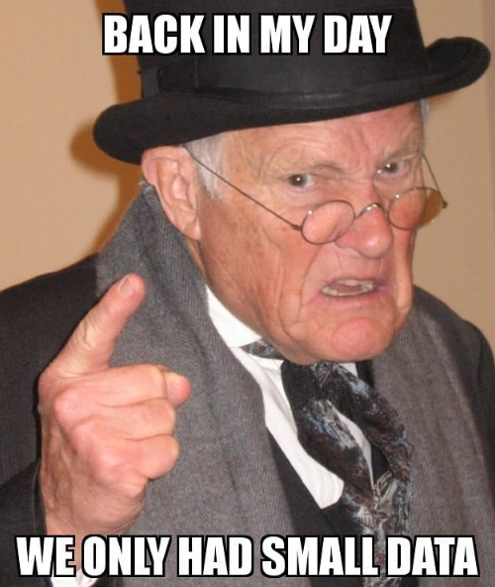
This uncle here is talking about traditional data.
Traditional data has these common features-
1.Structured and tabular in nature.
2.They are basically stored in databases
3.Can be accessed from a computer.

Slide 12
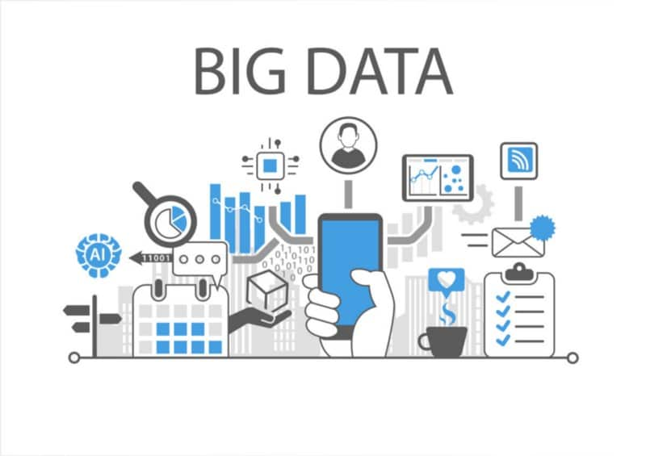
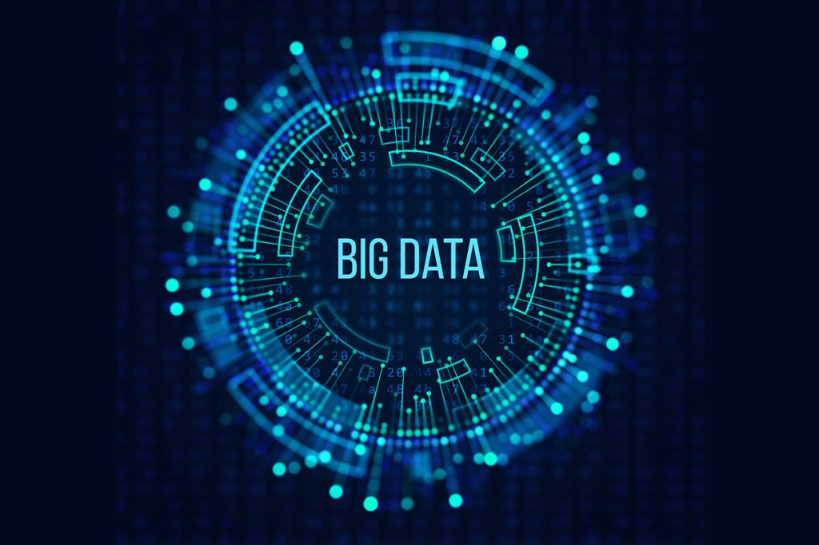
TRANSITIONING TO THE BIG DATA ERA

Slide 13
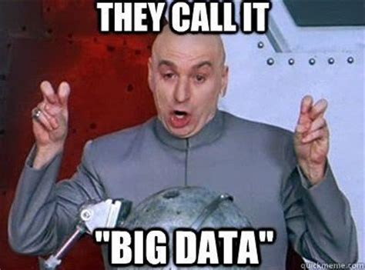
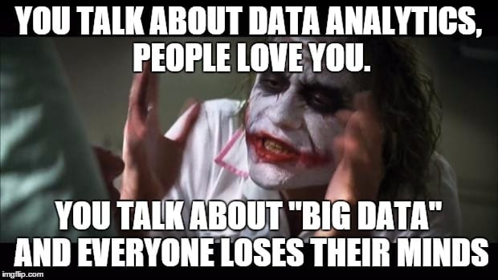
WELCOME TO THE WORLD OF BIG DATA

Slide 14
BIG DATA
Big data is the field that deals with extracting insights and patterns from very large data sets that are too complex to deal with traditional data processing systems.
Big data mostly is going to consist of extremely large data which may either be structured,semi structured or unstructured.
The rise of big data can be attributed to cloud computing or on demand computing as it provided people with the necessary resources in order to target these massive amounts of data.

Slide 15
SOURCES OF BIG DATA
Sensor Data
Genomic Data
Social Interaction Data
Business Transactions
Web data
Multimedia Data or Heterogeneous Forms of Data
Geospatial Data

Slide 16
APPLICATIONS OF BIG DATA-1
GENOMIC DATA SEQUENCING
Genome sequencing is the process of determining the complete DNA sequence of an organism’s genome at a single time.
The total length of the human genome is about 3 million base pairs long.
It is being said that if this genomic data can be completely sequenced we would be closer to the code of life.

Slide 17
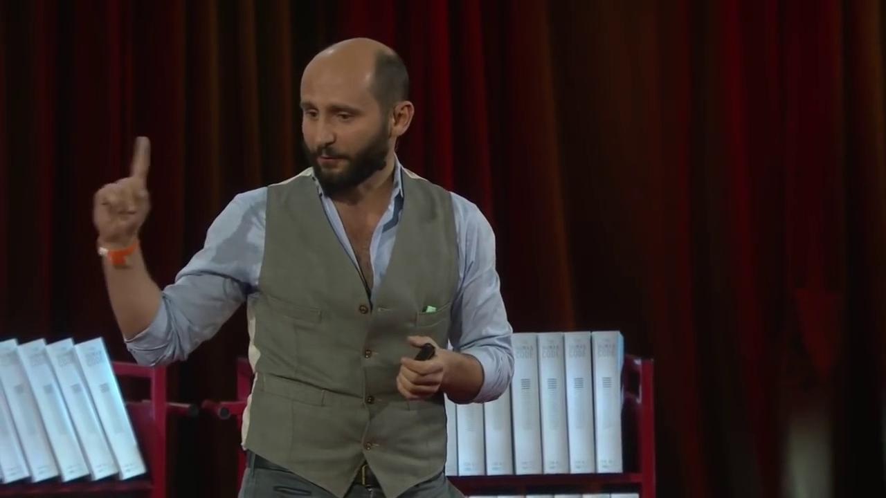
Video

Slide 18
How does genomic data sequencing become a big data problem?
It has been estimated for now that it would be possible to sequence 2 billion genomes by 2025 and the total size of the genomic data after sequencing would be 2 to 40 exabytes.
1 exabyte is roughly equal to 1 into 10^18 byte.
This whole thing would require 100,000 trillion CPU cycles to process.
After working with this big data using machine learning models can be made that convert the genome into phenotype and predict the actual features.

Slide 19
APPLICATIONS OF BIG DATA-2
PREDICTING FOREST FIRES
How forest fires have affected Australia?
24 people have been killed till now in bushfires.
More than 12 million acres of land has been destroyed
Australia being a biodiversity hotspot, these forest fires have affected numerous wildlife there.
The pollution in case of sydney was around 11 times the hazardous range
These forest fires can be attributed to a number of different scenarios but can these be predicted?

Slide 20
WILDFIRE ANALYTICS
Wildfire analytics can be done because of streams generated by people,organization and sensors.
It becomes a data problem because there is the presence of diverse data.
Sensor data comes from onland sensors or satellite data.
Organizational data comes from institutions.
Lot of data is actually generated by the public though twitter,facebook and instagram posts

Slide 21
INTEGRATION OF DIFFERENT DATA STREAMS
PEOPLE
SENSORS
WILDFIRE ANALYTICS
ORGANIZATION

Slide 22
THE V’S OF BIG DATA
Velocity
Variety
Volume
Veracity
These V’s can be extended even to 11 V’s to clear the characteristics of big data.

Slide 23
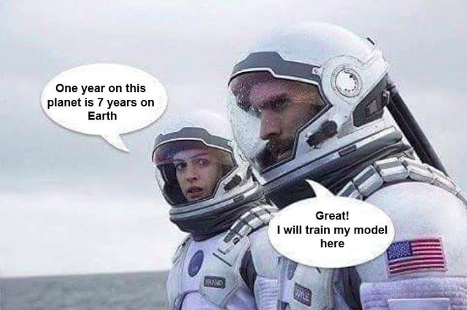
MACHINE LEARNING IN BIG DATA

Slide 24
APPLICATION OF MACHINE LEARNING IN BIG DATA
Machine Learning is the method of data analytics that automates model building.
Using algorithms that iteratively learns from data machine learning help computers to extract insights from the data without being explicitly programmed where to look.
ML has widespread application in big data as it makes the analysis easier.

Slide 25
MACHINE LEARNING CAN BE DIVIDED INTO
Supervised Learning-In case of supervised learning basically we are going to provide labelled data to the model for training.
Unsupervised Learning-In case of unsupervised learning we are going to provide unlabelled data to the model and the model is going to understand the similarity and the differences and based on that we are going to extract the insights.
Reinforcement Learning-In case of reinforcement learning there is mostly an agent in an environment and the agent needs to achieve a certain goal and there is a reward function that basically rewards the actor on taking the right decision to achieve the goal.

Slide 26
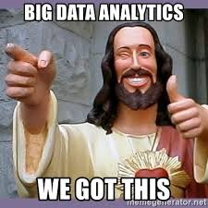
THANK YOU FOR YOUR TIME

